Slide 1
例题1
现有两个并发执行的进程。
问：
它们能正确执行吗？
若不能，请说明原因，并改正之。
int x;
Process p1 {
int y,z;
x=1;
y=0;
if x>=1 then y++;
z=y; }
Process p2 {
int t,u;
x=0;
t=0;
if x<1 then t=t+2;
u=t; }

Slide 2
solution
现有两个并发执行的进程。
问：
它们能正确执行吗？
若不能，请说明原因，并改正之。
int x;
Process p1 {
int y,z;
x=1;
y=0;
if x>=1 then y++;
z=y; }
Process p2 {
int t,u;
x=0;
t=0;
if x<1 then t=t+2;
u=t; }

Slide 3
例题2
有四个并发进程分别含有下述语句，试用信号量及wait、signal操作写出他们能正确执行的程序；
s1：a:=x+y;
s2：b:=z+1;
s3：c:=a-b;
s4：w:=c+1;

Slide 4
例题3
某数据采集与处理系统由一个数据采集进程与一个数据处理进程组成，它们共享一个缓冲区，
  （1）描述两进程之间的制约关系；
  （2）请利用记录型信号量机制和wait、signal操作解决这两个进程的同步问题，写出相应的算法描述；

Slide 5
例题4
某媒体播放器由一组循环使用的缓冲区及两个并发的播放进程与接收进程组成，其中，
  (1) 8个缓冲区构成一个循环链表，用于缓存要播放的媒体流；
  (2) 接收进程负责从服务器端接收欲播放的媒体流，并依次放入缓冲区中；
  (3) 播放进程依次从缓冲区中取出媒体流播放；
请利用信号量机制和wait、signal操作解决这两个进程的同步问题，写出相应的算法描述；

Slide 6
例题5
设有三个进程A、B、C，其中A与B构成一对P－C问题，共享一个由n个缓冲区组成的缓冲池；B与C构成一对P－C问题，共享一个由m个缓冲区组成的缓冲池。试用记录型信号量机制及wait与signal操作实现它们的同步。

Slide 7
例题6
生产者－消费者问题中，考虑无限长的消息队列的同步问题；

Slide 8
例题7
三个进程共享一个缓冲区。一个计算进程送数；一个加工进程取出加工，然后将加工结果再送回缓冲区；一个输出进程将加工后的数据取出打印。缓冲区中每次只能存放一个数。

Slide 9
例题8
三个进程共享一个缓冲区。一个负责向缓冲区送数；一个取偶数输出，另一个取奇数输出。缓冲区中每次只能存放一个数。

Slide 10
例题9
四个进程共享一个缓冲区，一个送偶数，一个送奇数，一个取偶数，一个取奇数。缓冲区中每次只能存放一个数。

Slide 11
例题10
四个进程共享一个缓冲区，一个送偶数，一个送奇数，一个取偶数，一个取奇数。缓冲区中每次能存放两个数。

Slide 12
例题11
围棋拣子问题：
  数量相等的黑子与白子混在一起，利用两个进程分开。一个进程拣白子，另一个进程拣黑子。要求：
（1）两个进程不能同时拣子；
（2）一个进程拣了一个子，必须让另一个进程拣子；即两个进程应交替拣子；
（3）假定先拣黑子。

Slide 13
例题12
幸福家庭问题
  桌子上有一只盘子，每次只能放入一个水果。爸爸专向盘中放苹果，妈妈专项盘中放桔子，一个女儿专等吃盘中的苹果，一个儿子专等吃盘中的桔子。试用P、V操作写出他们能同步的程序。

Slide 14
例题13
有一个仓库，可以存放X与Y两种产品，仓库的存储空间足够大，但要求：
（1）每次只能存入一种产品（X或Y）；
（2）-N<A产品数量 – B产品数量<M；
其中，N和M是正整数。
试用“存放A”和“存放B”和wait、signal描述产品A与产品B的入库过程。

Slide 15
分析：表达式“-N<A产品数量 – B产品数量<M”可以分解成两个表达式：
  “-N<A产品数量 – B产品数量”
  “A产品数量 – B产品数量<M”
即“存放A”的操作次数不能比“存放B”的次数少N-1次，“存放A”的操作次数不能比“存放B”的次数多M-1次；

Slide 16
类比
在生产者-消费者问题中，假定缓冲池中有n个缓冲区，开始时有m个满缓冲区；
则
  生产者的执行的次数比消费者的执行次数最多不能超过n-m次；
  消费者的执行次数比生产者的执行次数最多不能超过m次；
因此，设定信号量的初值为：
  empty=n-m
  full=m

Slide 17
Process Input {
while （1） {
Get product X;
IF X=A THEN {
wait(sa);
wait(mutext);
put product X into the depository;
signal(mutext);
signal(sb); }
ELSE IF （X=B） {
wait(sb);
wait(mutext);
put product X into the depository;
signal(mutext);
signal(sa);
}
}

Slide 18
例题14
有一个仓库存放两种零件A和B，最大库容各为m个。有一个车间不断地取A和B进行装配，每次各取一个。为避免零件锈蚀，遵循先入库者先出库的原则。有两组供应商分别不断地供应A和B（每次一个）。为保证齐套和合理库存，当某种零件的数量比另一种的数量超过n（n<m）个时，暂停对数量大的零件的进货，集中补充数量少的零件。试用wait和signal正确实现之。

Slide 19
该题的控制关系有4个：
  A的数量 – B的数量 <= n
  B的数量 – A的数量 <= n
  A的数量 <= m
  B的数量 <= m

Slide 20
由三个程序组成：
  放A
  放B
  取A与B

Slide 21
process Input_A
while (1) {
wait(availa);
wait(sa);
wait(mutext);
put product A into the depository;
signal(mutext);
signal(fulla);
signal(sb);
}

Slide 22
Process Input_B {
while (1) {
wait(availb);
wait(sb);
wait(mutex);
put product B into the depository;
signal(mutex);
signal(fullb);
signal(sa);
}

Slide 23
Process get_product_A_B {
while (1) {
wait(fulla);
wait(fullb);
wait(mutex);
get product A and B from the depository;
signal(mutex);
signal(availa);
signal(availb);
}

Slide 24
semorphore
mutex:=1;
Availa:=m;
Fulla=0;
Sa:=n;
Availb:=m;
Fullb:=0;
Sb:=n;

Slide 25
例题15
有一阅览室，共有100个座位。读者进入时必须先在一张登记表上登记，该表为每一作为列一个目录，包括座号与读者姓名。读者离开时要销掉登记内容。试用记录型信号量机制及wait与signal操作描述读者之间的同步。

Slide 26
例题16
汽车过桥问题

Slide 27
例题17
对于读者写者问题，
  （1）说明进程间的相互制约关系，应设哪些信号量？
  （2）用wait和signal写出其同步算法。
  （3）修改上述算法，使它对写者优先，即一旦有写者到达，后续的读者都必须等待，而无论是否有读者在读文件。

Slide 28
设置一个信号量，当有写者到来时，封锁后续的读者；

Slide 29
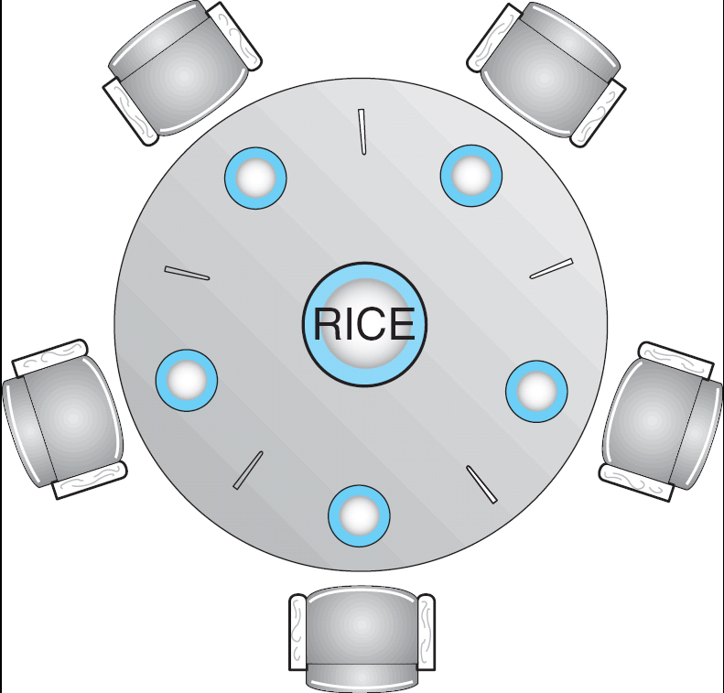
Dining-Philosophers Problem
Shared data
  Bowl of rice (data set)
  Semaphore chopstick [5] initialized to 1

Slide 30
Dining-Philosophers Problem (Cont.)
The structure of Philosopher i:
    While (true) {
    wait ( chopstick[i] );
    wait ( chopStick[ (i + 1) % 5] );
    // eat
    signal ( chopstick[i] );
    signal (chopstick[ (i + 1) % 5] );
    // think
    }

Slide 31
Allow at most four philosopher to be sitting simultaneously at the table;
Allow a philosopher to pick up her chopsticks only if both chopsticks are available;
Use a asymmetric solution; an odd philosopher picks up first her left chopstick and then her right chopstick, whereas an even philosopher picks up her right chopstick and then her left chopstick;
The last philosopher pick up her right chopstick first and the her left; the others pick up her left chopstick first and the her right;

Slide 32
Dining-Philosophers Problem-1
Semaphore seat＝4，chopstick[i]=1(i=1..5);
Philosopher i:
do {
wait(seats)
wait(chopstick[i])
wait(chopstick[(i+1) % 5])
…
eat
…
signal(chopstick[i]);
signal(chopstick[(i+1) % 5]);
signal(seats)
…
think
…
} while (1);

Slide 33
Dining-Philosophers Problem-2
信号量集

Slide 34
Dining-Philosophers Problem-3
Philosopher i:
do {
if (i%2==0) {
wait(chopstick[i])
wait(chopstick[(i+1) % 5]) }
else
wait(chopstick[(i+1) % 5])
wait(chopstick[i]) }
…
eat
…
signal(chopstick[i]);
signal(chopstick[(i+1) % 5]);
…
think
…
} while (1);

Slide 35
Dining-Philosophers Problem-4
Philosopher i:
do {
wait(mutex)
if (i<=4) {
wait(chopstick[i])
wait(chopstick[(i+1) % 5]) }
else {
wait(chopstick[(i+1) % 5])
wait(chopstick[i]) }
signal(mutex)
…
eat
…
signal(chopstick[i]);
signal(chopstick[(i+1) % 5]);
…
think
…
} while (1);

Slide 37
Java Synchronization
Synchronized, wait(), notify() statements
Multiple Notifications (notifyall())
Block Synchronization
Java Semaphores
Java Monitors

Slide 38
synchronized Statement
Every object has a lock associated with it.
Calling an ordinary method the lock is ignored.
But, calling a synchronized method requires “owning” the lock.

Slide 39
synchronized Statement
If the lock is available when a synchronized method is called , the calling thread becomes the owner of the object’s lock.
If a calling thread does not own the lock (another thread already owns it), the calling thread is blocked and is placed in the entry set for the object’s lock.
The lock is released when a thread exits the synchronized method, and the JVM selects an arbitrary thread from entry set as the new owner of the lock.

Slide 40
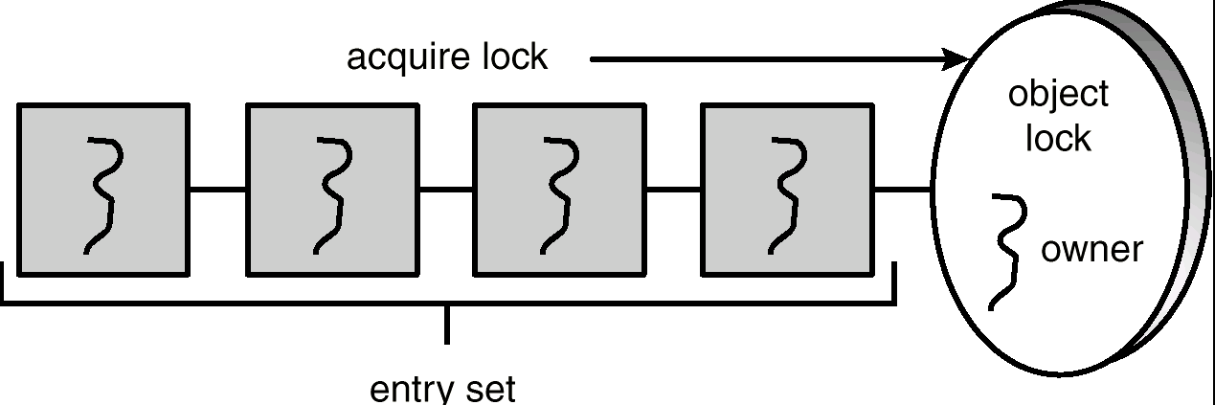
Entry Set
注：Entry set 中的线程处于阻塞状态
也有的处于runnable状态（后面还要介绍）；

Slide 41
enter() Method - busy waiting without synchronized
public void enter(Object item) {
while (count == BUFFER_SIZE) ;
++count;
buffer[in] = item;
in = (in + 1) % BUFFER_SIZE;
}

Slide 42
remove() Method - busy waiting without synchronized
public Object remove() {
Object item;
while (count == 0) ;
--count;
item = buffer[out];
out = (out + 1) % BUFFER_SIZE;
return item;
}

Slide 43
Problems
The specification for the JVM does not indicates whether threads are time-sliced or not. It is up to the particular implementation of the JVM.
Usually, the JVM schedules threads using a preemptive, priority-based schedules algorithm.
So if no higher priority threads arrive, the executing thread will never relinquishes control of the CPU;

Slide 44
problems
Race condition:
  shared variables: count, in and out
Solution:
  synchronized method

Slide 45
enter() Method - busy waiting with synchronized
public synchronized void enter(Object item) {
while (count == BUFFER_SIZE) ;
++count;
buffer[in] = item;
in = (in + 1) % BUFFER_SIZE;

Slide 46
remove() Method - busy waiting with synchronized
public synchronized Object remove() {
Object item;
while (count == 0) ;
--count;
item = buffer[out];
out = (out + 1) % BUFFER_SIZE;
return item;
}

Slide 47
problems
Busy waiting
  Maybe the executing thread never relinquishes control of the CPU;
Solution:
  yield();

Slide 48
problems
Can leads to a deadlock;
Assume the producer owns the lock and the buffer is full, it is busy waiting and still keeps the lock.
When the consumer is scheduled to run, the consumer will be blocked and is placed in the entry set for the object’s lock.
Then
  The producer is waiting for the consumer to free space in the buffer;
  The consumer is blocked waiting for the producer to release the lock.

Slide 49
yield() method
When a thread invokes the yield() method, the thread stays in the runnable state, but it relinquishes control of the CPU and allows the JVM to select to run anther runnable thread of equal priority.
The yield() method makes more effective use of the CPU than busy waiting does.

Slide 50
synchronized enter() Method with yield
public synchronized void enter(Object item) {
while (count == BUFFER_SIZE)
Thread.yield();
++count;
buffer[in] = item;
in = (in + 1) % BUFFER_SIZE;
}

Slide 51
synchronized remove() Method with yield
public synchronized Object remove() {
Object item;
while (count == 0)
Thread.yield();
--count;
item = buffer[out];
out = (out + 1) % BUFFER_SIZE;
return item;
}

Slide 52
problems
Assume the producer owns the lock and the buffer is full;
The producer still keeps the lock;
When the consumer has an opportunity to be scheduled to run, the consumer will be blocked and is placed in the entry set for the object’s lock.
Then
  The producer is waiting for the consumer to free space in the buffer;
  The consumer is blocked waiting for the producer to release the lock.
So, Using either busy waiting or yielding could potentially lead to a deadlock.

Slide 53
The wait() Method
When a thread calls wait(), the following occurs:
  the thread releases the object lock.
  thread state is set to blocked.
  thread is placed in the wait set.

Slide 54
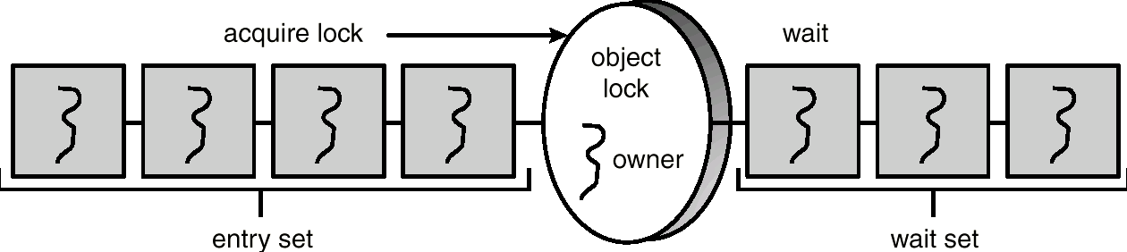
Entry and Wait Sets
1、own the lock
2、blocked or runnable
1、release the lock
2、blocked

Slide 55
The notify() Method
When a thread calls notify(), the following occurs:
  selects an arbitrary thread T from the wait set.
  moves T to the entry set.
  sets T to Runnable.
T can now compete for the object’s lock again.

Slide 56
enter() with wait/notify Methods
public synchronized void enter(Object item) {
while (count == BUFFER_SIZE)
try {
wait();
}
catch (InterruptedException e) { }
}
++count;
buffer[in] = item;
in = (in + 1) % BUFFER_SIZE;
notify();
}

Slide 57
remove() with wait/notify Methods
public synchronized Object remove() {
Object item;
while (count == 0)
try {
wait();
}
catch (InterruptedException e) { }
--count;
item = buffer[out];
out = (out + 1) % BUFFER_SIZE;
notify();
return item;
}

Slide 58
problems
notify() selects an arbitrary thread from the wait set.
  This may not be the thread that you want to be selected.
Java does not allow you to specify the thread to be selected.
Consider the case where there are multiple threads in the wait set and more than one condition for which to wait. (为完成一件事情需要满足多个条件)
  It is possible that a thread whose condition is still unmet may be the thread that receives the notification.
  Then this thread will be blocked again;
  For the worst case, the threads in the wait set were notified in a bad sequence, and they wait for other unmet conditions and then all of them would be blocked again.
Can also leads to a deadlock;

Slide 59
Multiple Notifications
notifyAll() removes ALL threads from the wait set and places them in the entry set. This allows the threads to decide among themselves who should proceed next.
notifyAll() is a conservative strategy that works best when multiple threads may be in the wait set.

Slide 60
enter() with wait/notifyall Methods
public synchronized void enter(Object item) {
while (count == BUFFER_SIZE)
try {
wait();
}
catch (InterruptedException e) { }
}
++count;
buffer[in] = item;
in = (in + 1) % BUFFER_SIZE;
notifyall();
}

Slide 61
remove() with wait/notify Methods
public synchronized Object remove() {
Object item;
while (count == 0)
try {
wait();
}
catch (InterruptedException e) { }
--count;
item = buffer[out];
out = (out + 1) % BUFFER_SIZE;
notifyall();
return item;
}

Slide 62
No deadlock occurs, but low efficient

Slide 63
Reader Methods with Java Synchronization
public class Database {
public Database() {
readerCount = 0;
dbReading = false;
dbWriting = false;
}
public synchronized int startRead() { /* see next slides */ }
public synchronized int endRead() { /* see next slides */ }
public synchronized void startWrite() { /* see next slides */ }
public synchronized void endWrite() { /* see next slides */ }
private int readerCount;
private boolean dbReading;
private boolean dbWriting;
}

Slide 64
startRead() Method
public synchronized int startRead() {
while (dbWriting == true) {
try {
wait();
}
catch (InterruptedException e) { }
++readerCount;
if (readerCount == 1)
dbReading = true;
return readerCount;
}

Slide 65
endRead() Method
public synchronized int endRead() {
--readerCount
if (readerCount == 0)
db.notifyAll();
return readerCount;
}

Slide 66
Writer Methods
public void startWrite() {
while (dbReading == true || dbWriting == true)
try {
wait();
}
catch (InterruptedException e) { }
dbWriting = true;
}
public void endWrite() {
dbWriting = false;
notifyAll();
}

Slide 67
Block Synchronization
Blocks of code – rather than entire methods – may be declared as synchronized.
This yields a lock scope that is typically smaller than a synchronized method.

Slide 68
Block Synchronization (cont)
Object mutexLock = new Object();
. . .
public void someMethod() {
// non-critical section
synchronized(mutexLock) {
// critical section
}
// non-critical section
}

Slide 69
Java Semaphores
Java does not provide a semaphore, but a basic semaphore can be constructed using Java synchronization mechanism.

Slide 70
Semaphore Class
public class Semaphore {
public Semaphore() {
value = 0;
}
public Semaphore(int v) {
value = v;
}
public synchronized void P() { /* see next slide */ }
public synchronized void V() { /* see next slide */ }
private int value;
}

Slide 71
P() Operation
public synchronized void P() {
while (value <= 0) {
try {
wait();
}
catch (InterruptedException e) { }
}
value --;
}

Slide 72
V() Operation
public synchronized void V() {
++value;
notify();
}

